Slide 1
Final Engagement
Attack, Defense & Analysis of a Vulnerable Network

Slide 2
Table of Contents
This document contains the following resources:
Network Topology & Critical Vulnerabilities
Traffic Profile
Normal Activity
Malicious Activity

Slide 3
Network Topology
& Critical Vulnerabilities
‹#›

Slide 4
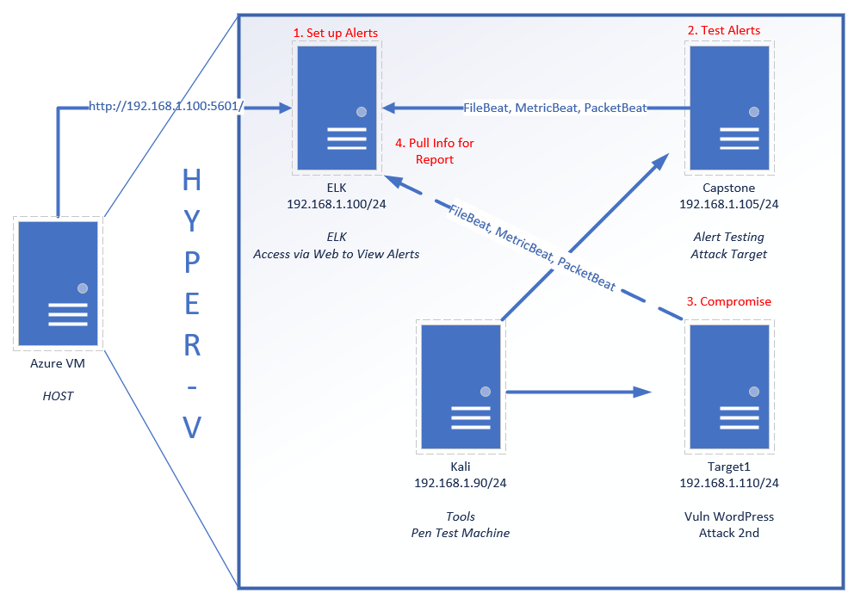
Network Topology
Network
Address Range:192.168.1.0/24
Machines
IPv4: 192.168.1.90
OS: Kali Linux
Hostname: Kali
IPv4: 192.168.1.100
OS: Ubuntu 18.04.4 LTS
Hostname: ELK
IPv4: 192.168.1.105
OS: Ubuntu 18.04.4 LTS
Hostname: Capstone
IPv4: 192.168.1.110
OS: Debian Linux Jessie
Hostname: Target 1
IPv4: 192.168.1.115
OS: Debian Linux Jessie
Hostname: Target 2

Slide 5
Critical Vulnerabilities: Target 1
Our assessment uncovered the following critical vulnerabilities in Target 1:
Vulnerability | Description | Impact
Insecure Password | User used their username as their password & password hashes were easily “cracked” | Allowed for SSH access to Target1 due to weak security. Also,
Unrestricted User Rights | User (michael) was allowed into folders on Target1 that the user didn’t need access to. | Allowed for directory traversal and viewing of files that contained privileged passwords.
Privilege Escalation | User(steven) had sudo rights to Python which allowed scripts to run as Root | A python script was able to be run with sudo which was able to spawn a Root level bash shell.
Notes:
Insecure Passwords were the largest vulnerability for target 1. On 3 occasions the passwords allowed for progression of the attack. 1. username=password. 2. Access to the mysql username & Password in clear text in a plain text file. 3. 6 character password that was cracked in 10 minutes using John the Ripper.
Privilege Escalation could have been handled by auditing sudo rights.

Slide 6
Critical Vulnerabilities: Target 2
Our assessment uncovered the following critical vulnerabilities in Target 2.
Vulnerability | Description | Impact
PHPMailer RCE: CVE 2016-10033 | Allows extra parameters to the mail command | Allows execution of arbitrary code
Privilege Escalation | Obtained through default username and password for root | Grants root access
Directory Listing | Lists files and directories that exist on a Web server | Allows unapproved entry to directories and files

Slide 7
Traffic Profile
‹#›

Slide 8
Traffic Profile
Our analysis identified the following characteristics of the traffic on the network:
Feature | Value | Description
Top Talkers (IP Addresses) | 172.16.4.205 (33M) 10.0.0.201 (19M) 185.243.115.84 (16M) | Machines that sent the most traffic.
Most Common Protocols | TLS HTTP DNS | Three most common protocols on the network.
# of Unique IP Addresses | 810 | Count of observed IP addresses.
Subnets | 192.168.1.0/24 172.16.4.0/24 10.6.12.0/24 10.0.0.0/24 | Observed subnet ranges.
Notes:
You may have more than 2 subnets.

Slide 9
Behavioral Analysis
Purpose of Traffic on the Network
Users were observed engaging in the following kinds of activity.
“Normal” Activity
Visiting a Blog Website - MySoCalledChaos.com
Downloading and installing Desktop Background
Suspicious Activity
Dropping Reverse Shell components
SSH logins
Downloading Torrents
Setup AD network and Domain Controller

Slide 10
Normal Activity
‹#›

Slide 11
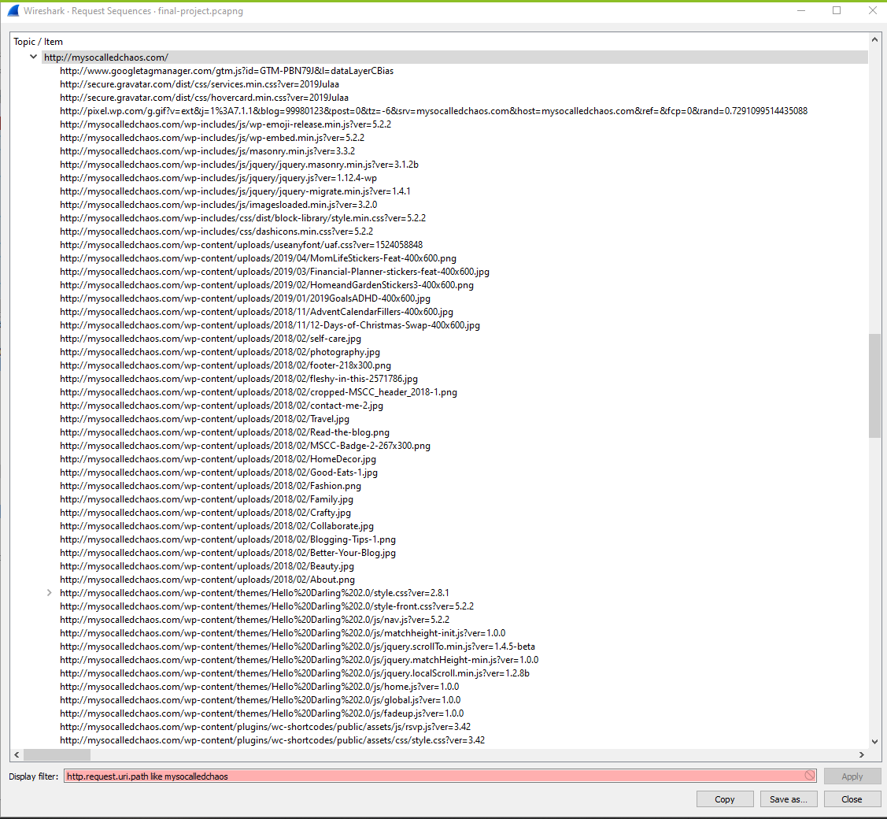
Web Browsing
Summarize the following:
HyperText Transfer Protocol
The user appeared to be editing a WordPress Blog, mysocalledchaos.com, Viewing Sabetha Hospital’s site.
Notes:
Used Wireshark -> Statistics -> HTTP-> Request Sequences.

Slide 12

Desktop Background
Summarize the following:
Protocols Used: HTTP
Img downloaded from green.mattingsolutions.co
empty.gif?ss&ss1img
Notes:
File ->Export Objects -> HTTP (comparing sizes of the empty.gif object downloaded to investigate)

Slide 13
Malicious Activity
‹#›

Slide 14
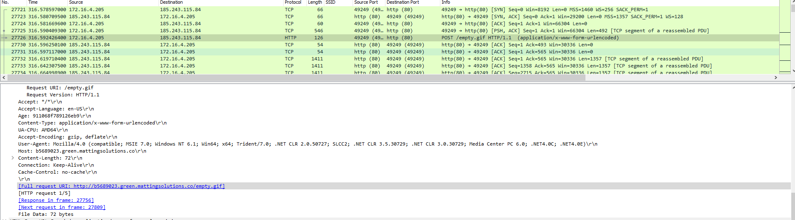
Reverse Shell
Summarize the following:
Use of HTTP to place a reverse shell script on a web server
The user was visiting http://b5689023.green.mattingsolutions.co/empty.gif
Notes:
The file uploaded was labeled as empty.gif. However, upon inspection of the file, there were no contents in a gif format. Strings were found inside of the files starting with a= & b= . Actual code wasn’t seen, but the activity after the file upload is a near continual stream of HTTP ACK packets.

Slide 15

Downloading Torrents
Summarize the following:
Use of HTTP to download a torrent file
The user was accessing www.mypublicdomaintorrents.com
Include screenshots of packets justifying your conclusions.
Downloaded torrent file: Betty_Boop_Rhythm_on_the_Reservation.avi.torrent

Slide 16
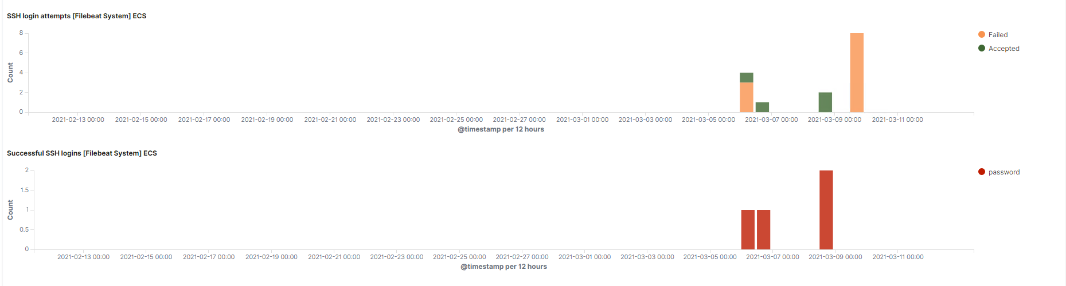
SSH Logins
Summarize the following:
The only SSH traffic observed by the SIEM was during the actual attacks, no other SSH logins were logged.
SSH was used for infiltration of the Target1 & Target2.

Slide 17
The End
‹#›

